Slide 1

Rotational Ordering
The movement of arm/head →delay, given each track has multiple sectors, we need an efficient way to best read data given a read sequence. Lets look at a simple example where we only have a single head…
SECTOR
Head
Request List:
Track
0
1
1
2
2
2
3
3
Sector
1
3
2
4
2
1
3
1
0
1
2
TRACK
0,0
0,1
0,2
1,0
1,1
1,2
2,0
2,1
2,2
Notes:
We can reduce rotational delay by ordering request by sectors…
Sector – sector = rotational delay
Track to track = head/arm delay

Slide 2
Example
Assume it only takes 1 ms to transfer a record (TX), 5ms track –track, 1 ms per sector (only 0-4 sectors)
Request
0,1
1,3
1,2
2,4
2,2
2,1
3,3
3,1
Seek
0
5
0
5
0
0
5
0
--
15
Search
1
1
3
1
2
3
1
2
---
14
TX
1
1
1
1
1
1
1
1
--
8
Total
2
7
4
7
3
4
7
3
---
37
0,1
1,2
1,3
2,1
2,2
2,4
3,1
3,3
0
5
0
5
0
0
5
0
--
15
1
0
0
2
0
1
1
1
---
6
2
6
1
8
1
2
7
2
---
29
Notes:
Black normal, Green sector grouped!
The obvious, black == normal request, green == sector grouped (re ordered).
TX is transfer time which is always 1 as we only read a sector/ block at a time.
Seek time is track to track (arm) delay this is will always be the same as we read data from tracks 0,1,2,&3.
The not so obvious....
It noted that this example the disk has only 0-4. Once we read a sector, the head is in the position to read the next sector. If we don't want to read the next sector we need to skip past the ones we don't want, this adds a delay (rotational), in this example its 1 ms for every sector.
looking at ...
Prior request..
1,3 so the head will be on track 1 and would have read sector 3, so its new position would be 1,4.
Next request...
1,2 so the head is on the correct track, but because a HDD spins in one direction only, its already at the start of sector 4, has to skip this as well as sector 0 & sector 1 to get to the correct position (start of sector 2) so skipping 3 sectors == 3ms delay (rotational).
Also note in this simple example, the head position stays in the same place (sector start) between track changes, not the case in real life.

Slide 3
RAID
Use lots of HDDs as a single HDD, making a logical device/partition which requires dedicated SW or HW.
Why?
Greater HDD capacity
Greater speed/ IO access
Introduce redundancy/ reliability
Notes:
Redundant array of inexpensive disks

Slide 4
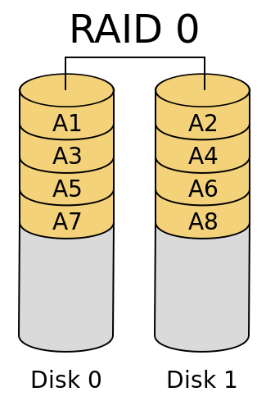
Raid 0
Zero redundancy
Data striped across 2+ HDD
Give faster/ parallel read/writes
Notes:
Best for non critical data, something you can afford to lose!

Slide 5
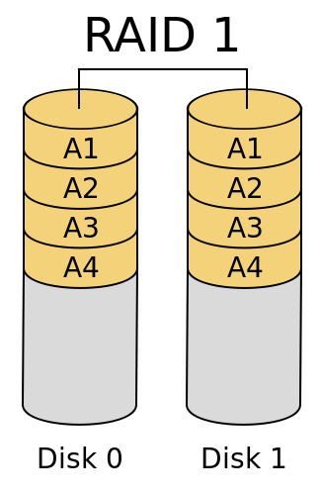
Raid 1
Data is mirrored on 1+ HDD
Read speeds increase by N
Write speed stays the same as 1 HDD
Notes:
Best for critical data as it has redundancy with lots of read , less write (ideal for a database)

Slide 6
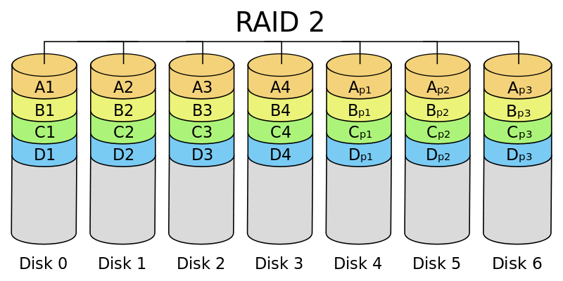
Raid 2 &3
Uses hamming codes (4 data 3 parity)
Data striped on bit level
Can correct 1 bit errors
Can recover from 1 HDD failure (re-generate from codes)
Raid 3 same as 2 but only uses one HDD to store hamming codes
Notes:
Both raid 2/3 have to recalculate the hamming code when new data is added or updated (slow!)
HDDs now use hamming code as their internal ECC, so raid 2 is no longer used
When using multiple disks, seek time is still == 1 HDD, only sequential read/write can be improved on, generally.

Slide 7
Raid 4/5/6
Raid 4: same stripe scheme as 1/0 with a separate HDD to store a parity (so it can recover from 1 HDD failure); Also allows for concurrent read/writes on different disks.
Raid 5: Same as 4 but parity is distributed across all disks
Raid 6: newest addition, uses an additional EEC produced by Berkeley Research, like 5 but now has 2 ECC to calculate, twice as slow & twice the storage to store ECC codes.

Slide 8
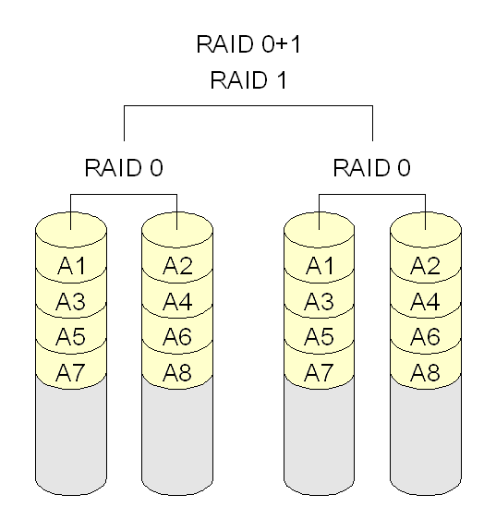
Nested Raid
01
Notes:
Mix of raids for performance & redundancy.
01,03,10,30,03,50
First RAID is the sub array, second is how to raid these sub arrays.

Slide 9
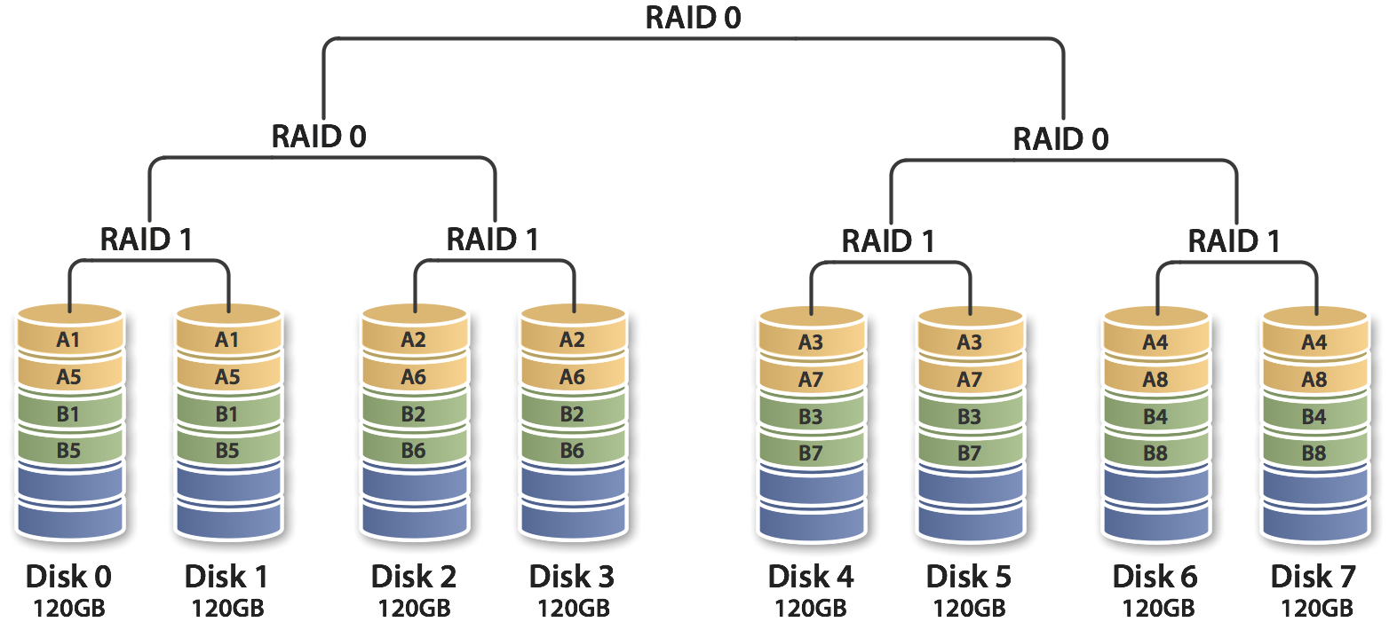
Nested Raid
100

